Slide 1
Eastwood Public School Online Parent Information Sessions Occupational Therapy Session 3: Pencil grasp & handwriting
Presented by Hazel Mujdeci – Peadiatric Occupational Therapist

Slide 2
Pencil Grasp
How to help hold our pencil correctly
Pinch and pop
Pom pom
Elastic band

Slide 3
Pencil Pressure
Too Light
Too Hard
Strengthening our hand muscles
Write with mechanical pencil (pacer)
Batteries sticky taped to end of pencil
Strengthening our hand muscles
Place paper on aluminum foil
Place paper on mouse pad

Slide 4
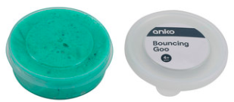
Finger warm-ups
Thumb taps
Pencil twirling
Pencil worms
Putty / play-dough
Hole punching

Slide 9
Sky Grass Dirt
The cat was sleeping.

Slide 10
Grass hills
cat
The
was sleeping.
cat
The
was sleeping.

Slide 11
Mudslides
The
was sleeping.
cat
The
was sleeping.
cat

Slide 12
T
h
c
a
e
t
The cat

Slide 13
Spacing
Spaceman
Finger spacing
Stickers

Slide 14
Thank you! Session 4: Self-care skills & eating challenges Tuesday 11th of August @ 7:30p.m.
Presented by Hazel Mujdeci: Peadiatric OT

