Slide 1

Eastwood Public School
Online Parent Information Sessions
Occupational Therapy
Session 1: Introduction to OT
Presented by Hazel Mujdeci – Peadiatric Occupational Therapist

Slide 2
What is attention & Concentration?
Attention
Concentration
Is the ability to focus on a task
Is the ability to maintain this attention (focus) for a certain amount of time

Slide 3
Try to read this
Answer the following:
5x 3 =
6x2 =
3x 4 =
8x 2 =
Show your working out
If Annie bought 10 strawberries and ate 2 strawberries a day, how many days would she have strawberries for?

Slide 4
Try to read this
Answer the following:
5x3 =
6x2 =
3x4 =
8x2 =
If Annie bought 10 strawberries and ate 2 strawberries a day, how many days would she have strawberries for?

Slide 5
Does my child have attention & concentration difficulties?
If a child has difficulties with attention and concentration they might;
Not attend to a task when required/requested to do so.
Miss details in instructions.
Repeatedly makes the same mistakes (due to not learning from past attention).
Be unable to listen to all of the information presented.
Find it physically difficult to either calm down (as they are too physically active) or to ‘wake up’ as they appear sleepy and lethargic.
Begins a task but then gets distracted by something else and then ‘forgets’ to complete what was asked of them.

Slide 6
What problems can occur?
When a child has attention difficulties, they might also have difficulties with:
Learning new skills
Successful social interaction
Inability to follow instructions
Receptive (understanding) language
Auditory processing (accurately understanding verbal information)
Hearing

Slide 7
What can be done to improve attention & concentration?
Repeat instructions
Eye contact
Simple language
Weighted items on lap
Bouncy band

Slide 8
Clutter & distraction free environment
Ensure the space that your child is working in is as clean and tidy as possible
Limit excessive art work, posters, colours and clutter
Provide good lighting – child facing a window with natural sunlight
Some children work better with background noise (Television, music, people talking) whereas some children prefer no background noise
Keep everything at hand so everything is easily accessible
Cover half of page / show 1 question at a time

Slide 9
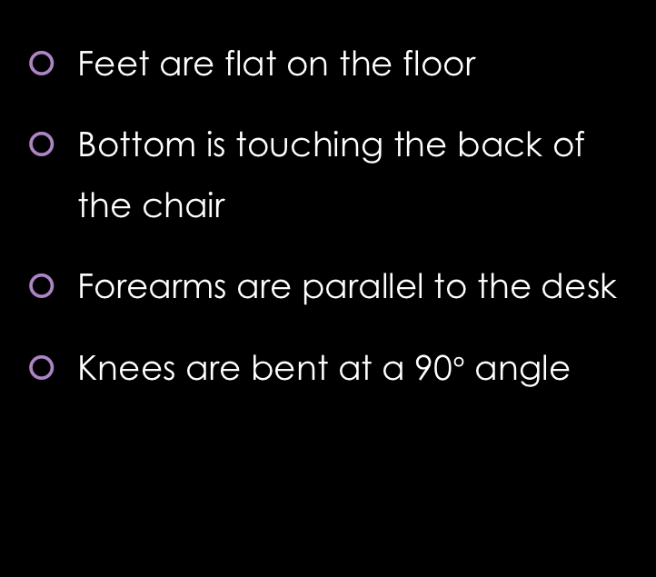
How to sit correctly on a chair
Feet are flat on the floor
Bottom is touching the back of the chair
Forearms are parallel to the desk
Knees are bent at a 90$°$ angle

Slide 10

Routines and Schedules
Set expectations
Set normalcy
Decrease anxiety
Child knows exactly what is going to happen everyday
Parent is required to be consistent
Child can switch ‘on’ before homework

Slide 11
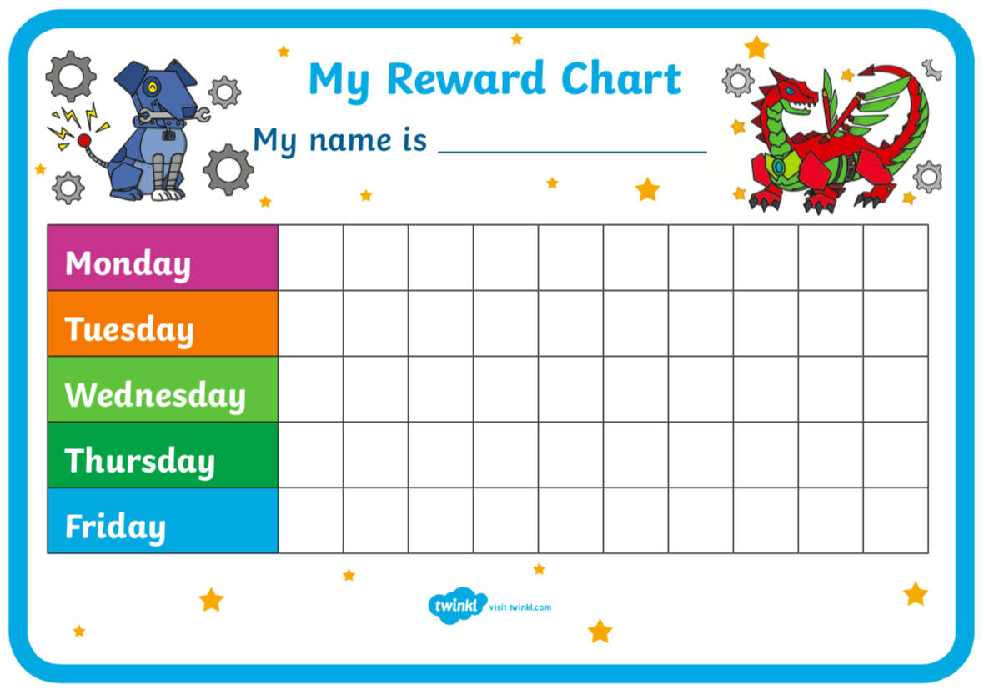
Reward Chart
Provide positive reinforcement
Provide child-chosen rewards
Something to work toward
Increase motivation

Slide 12

Set time goals
An adult can concentrate for up to 40 minutes at a time. For children, it is between 4-20 minutes.
Provide short breaks in-between timer (5 mins on I-pad, dance break, play with toys).
Challenges children to try and get as much work done in the set time

Slide 13
FOOD!
Studies show that what a child eats is directly correlated to their attention and concentration
Eating junk food or foods rich in sugar and caffeine can make children sluggish
Eating foods rich in proteins & fatty fish have been studied to raise awareness and increase concentration levels:
- Fish
- Eggs
- Nuts
- Beans
- Chickpeas
- Lentils
- Blueberries
- Broccoli
- Dark chocolate
- Oranges

Slide 14
Movement Breaks
Research
How?
Research shows that information is more effectively retained when there are short breaks in between new material that is learnt.
Physical activity increases oxygen to the brain
Movement breaks allowing interruption in anxiety and any stress they make be experiencing
Allow for regulating children’s emotions
Between homework activities
YouTube exercise video
10 star jumps
10 wall push ups

Slide 15
Thank you!
Session 3: How to hold a pencil + handwriting tips and tricks
Tuesday 4th of August @ 7:30p.m.
Presented by Hazel Mujdeci: Peadiatric OT

